Slide 1

Using a reference manager
DEPH 312 Principles of Scientific Evidence
Talal Alshihayb
24 January 2023
shihaybt@ksau-hs.edu.sa

Slide 2
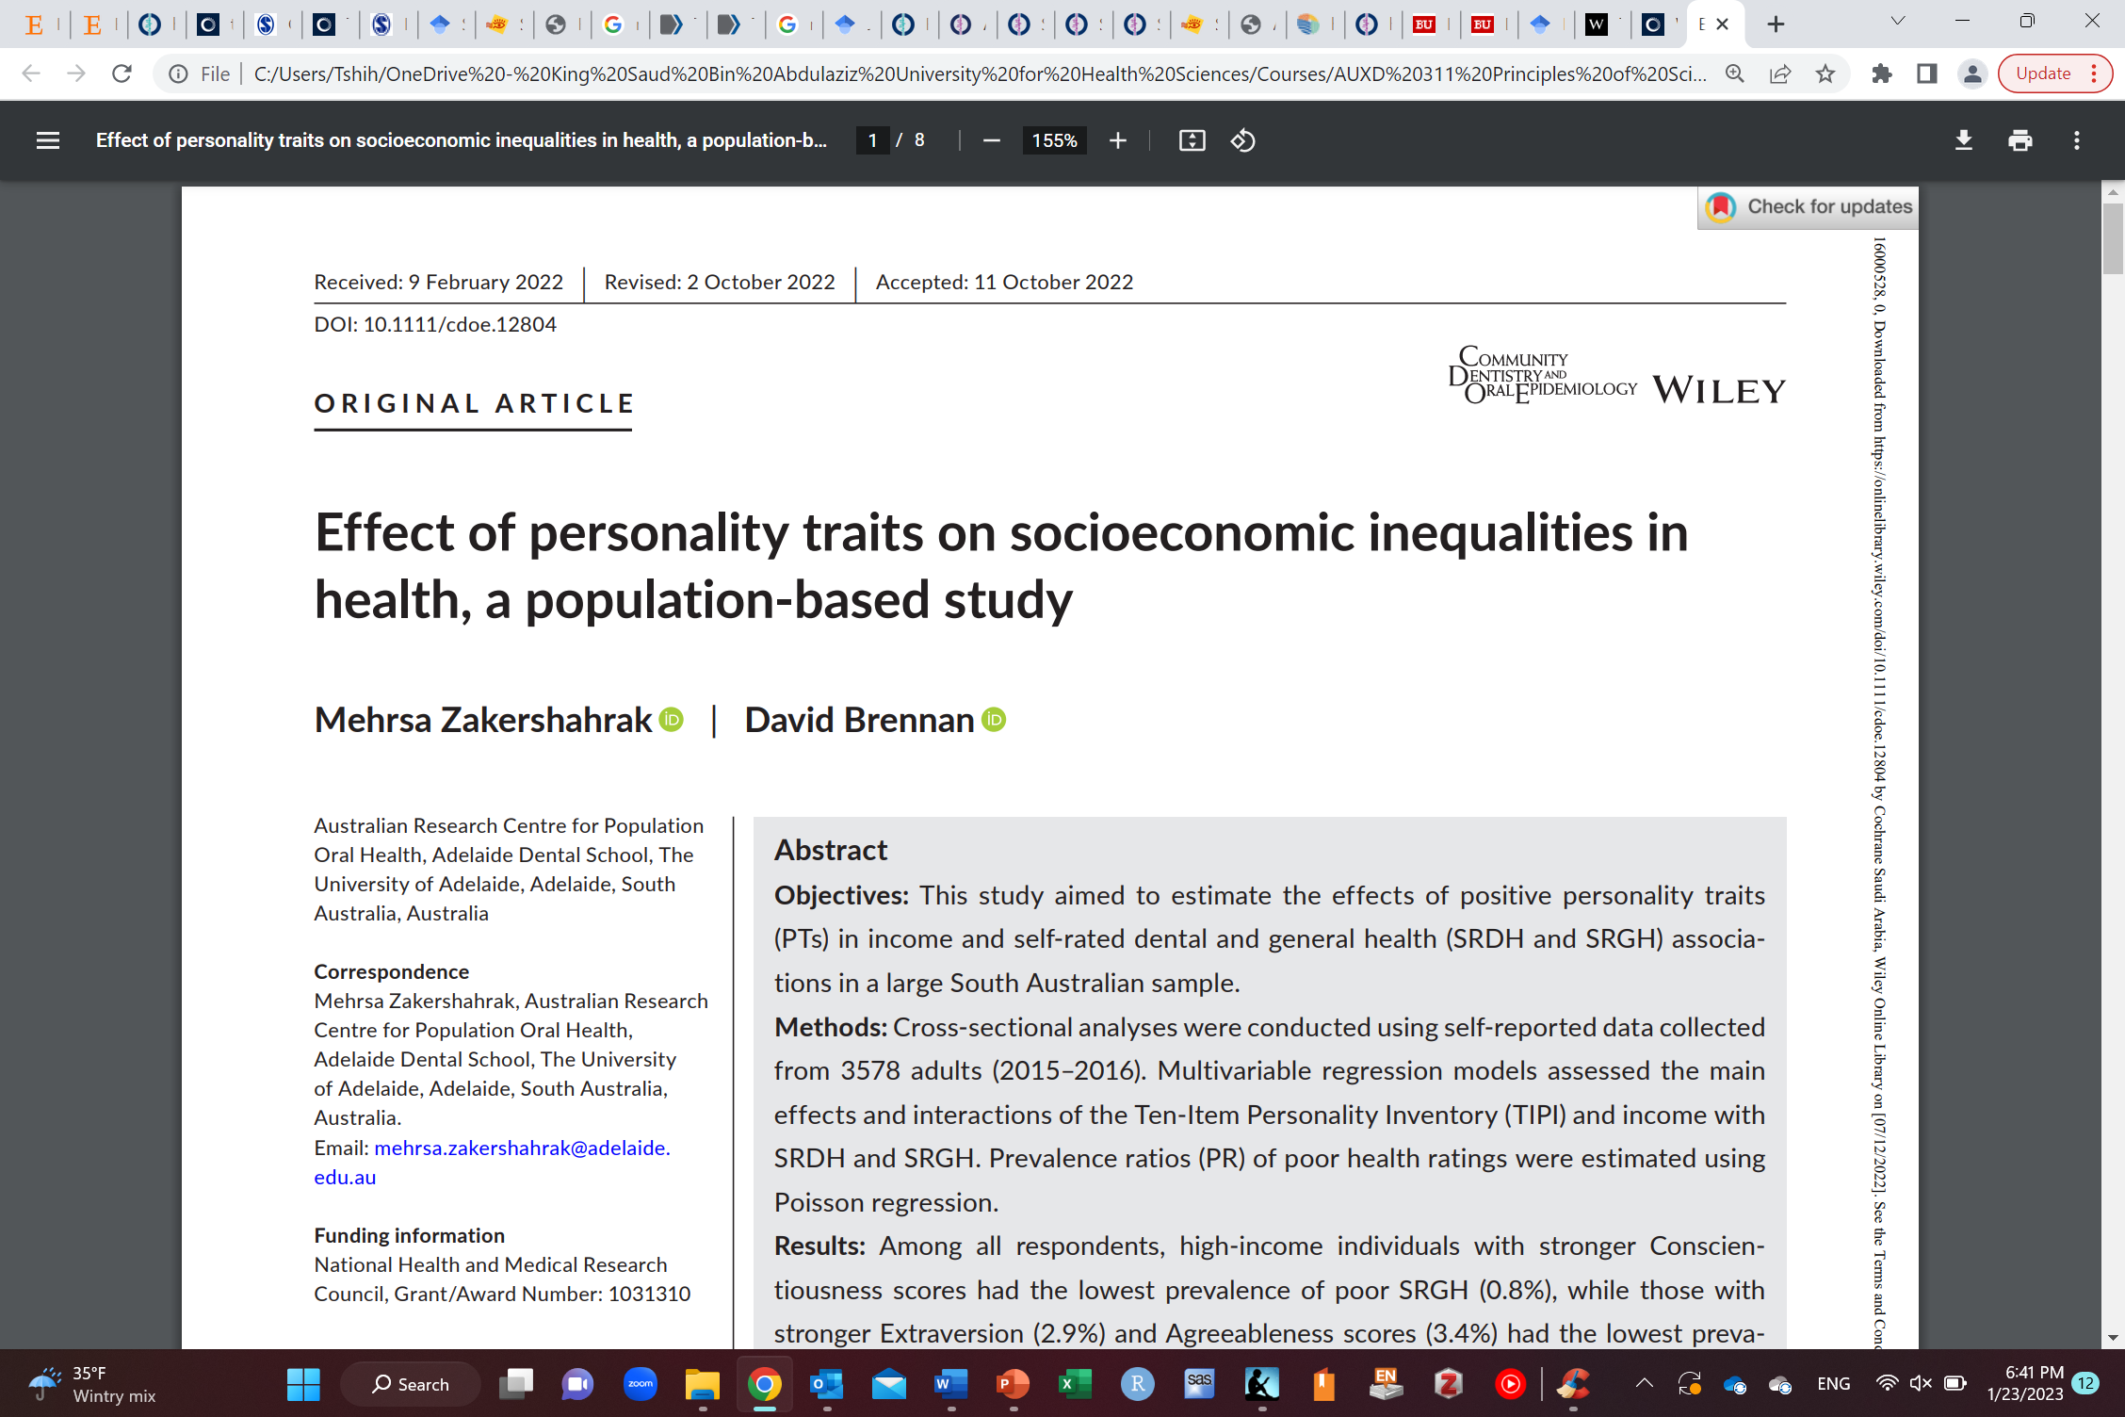
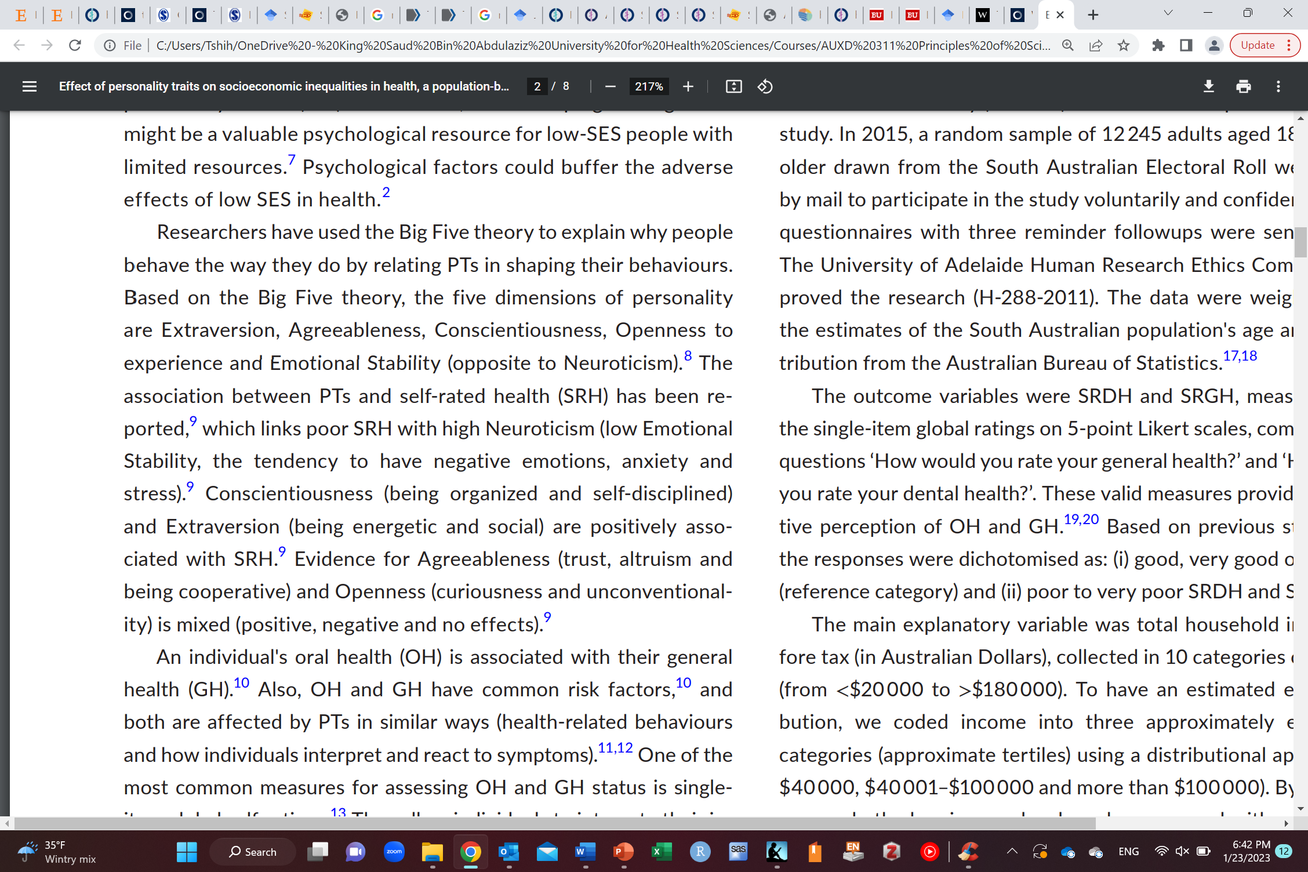

Slide 3
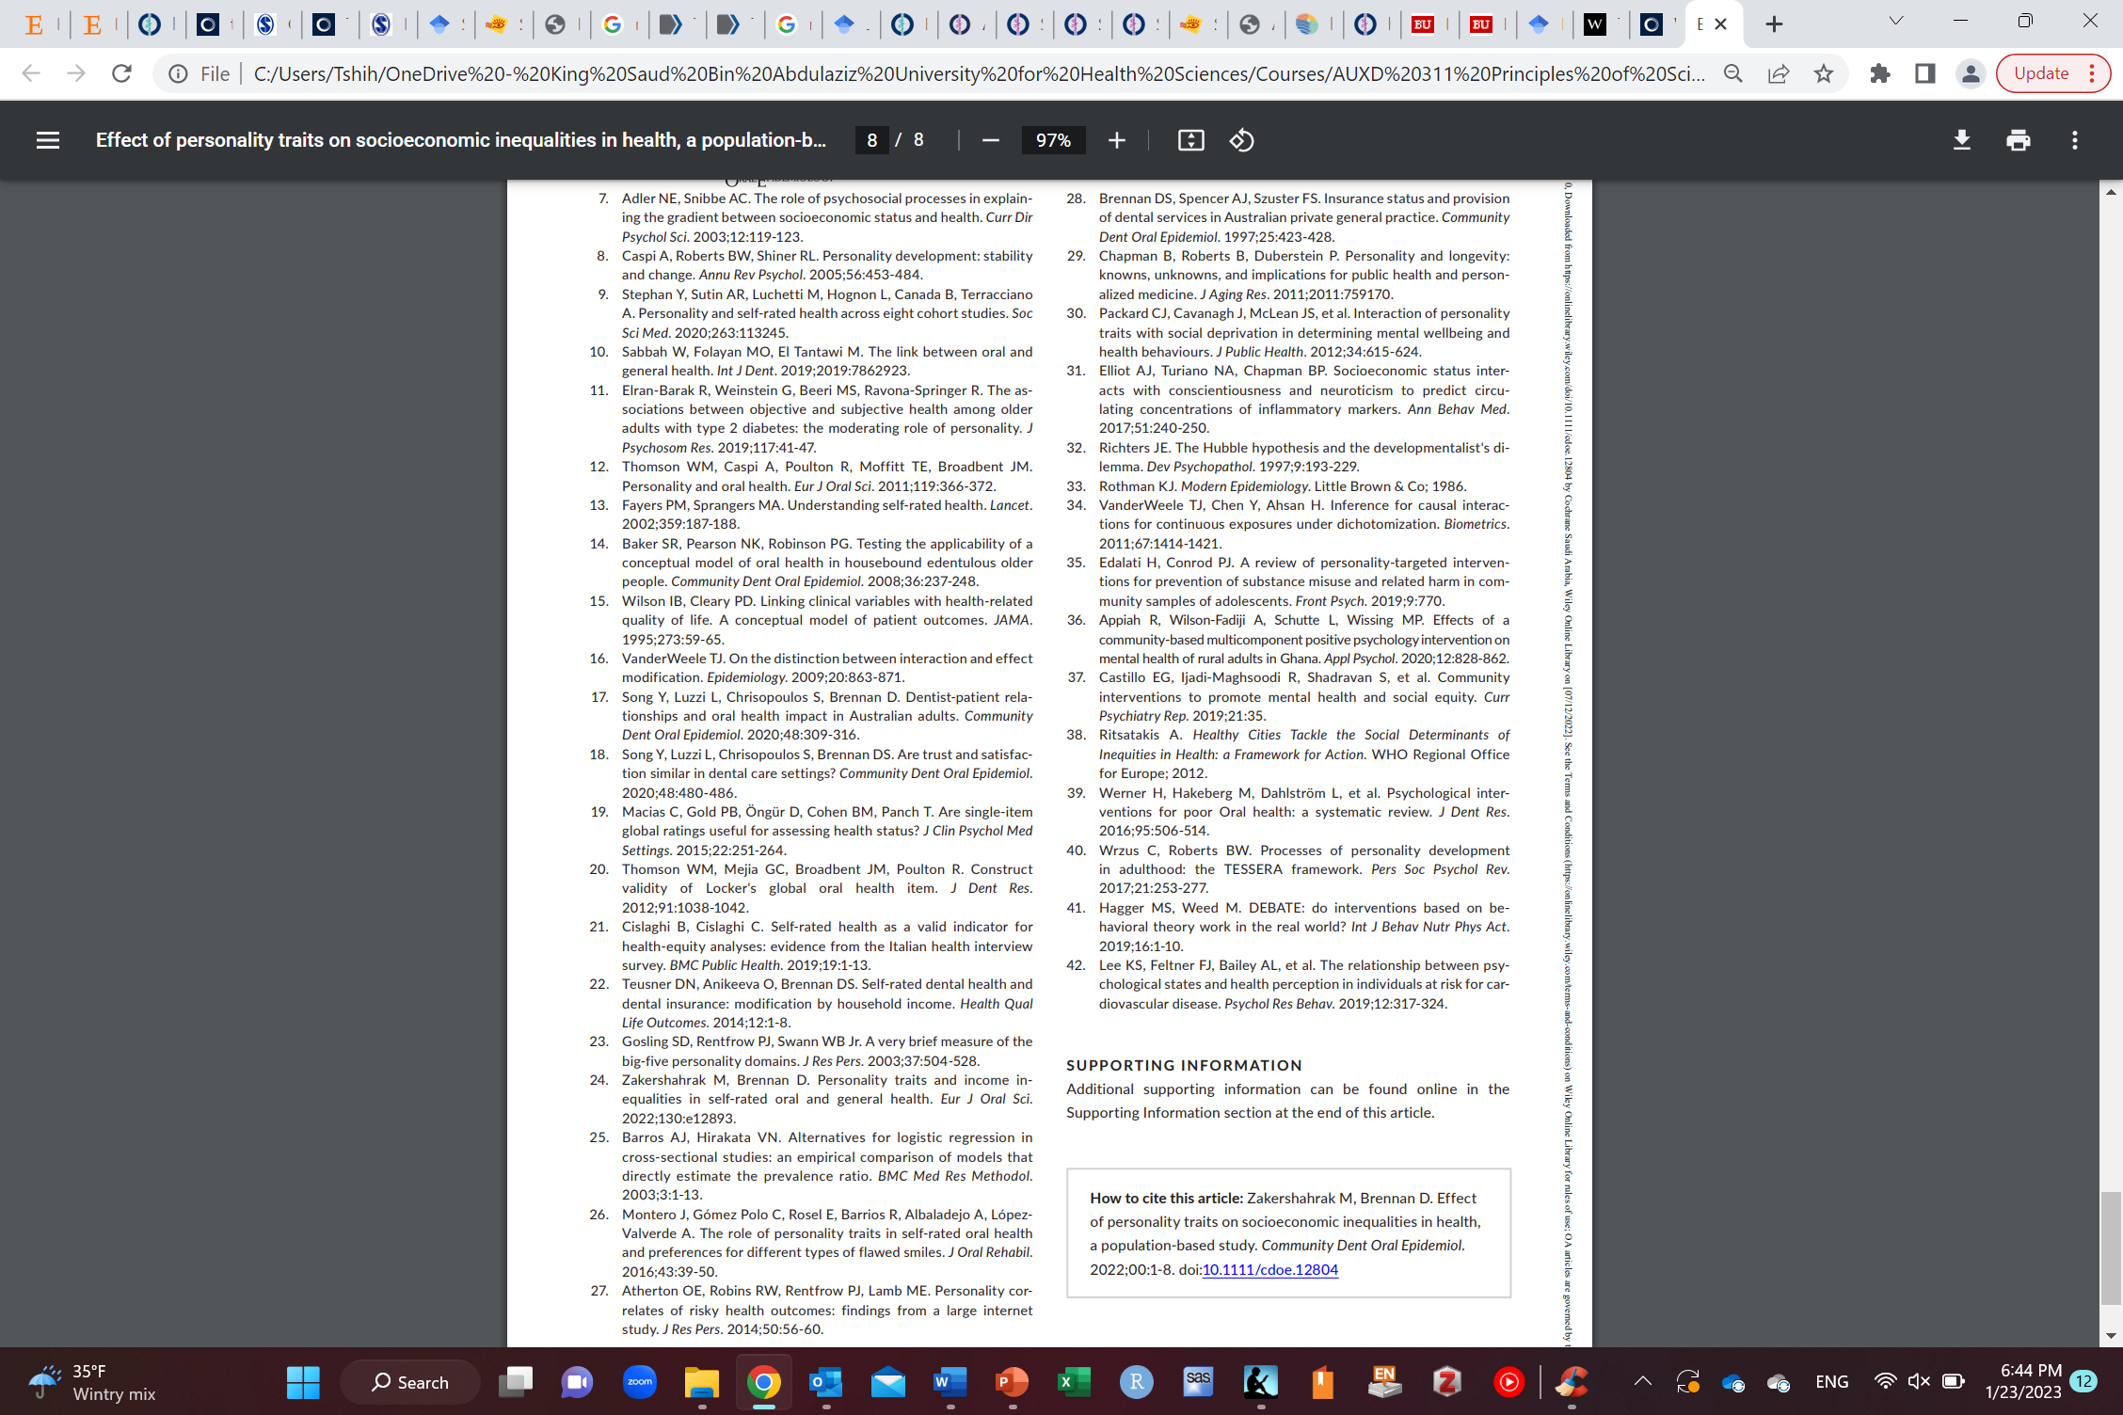
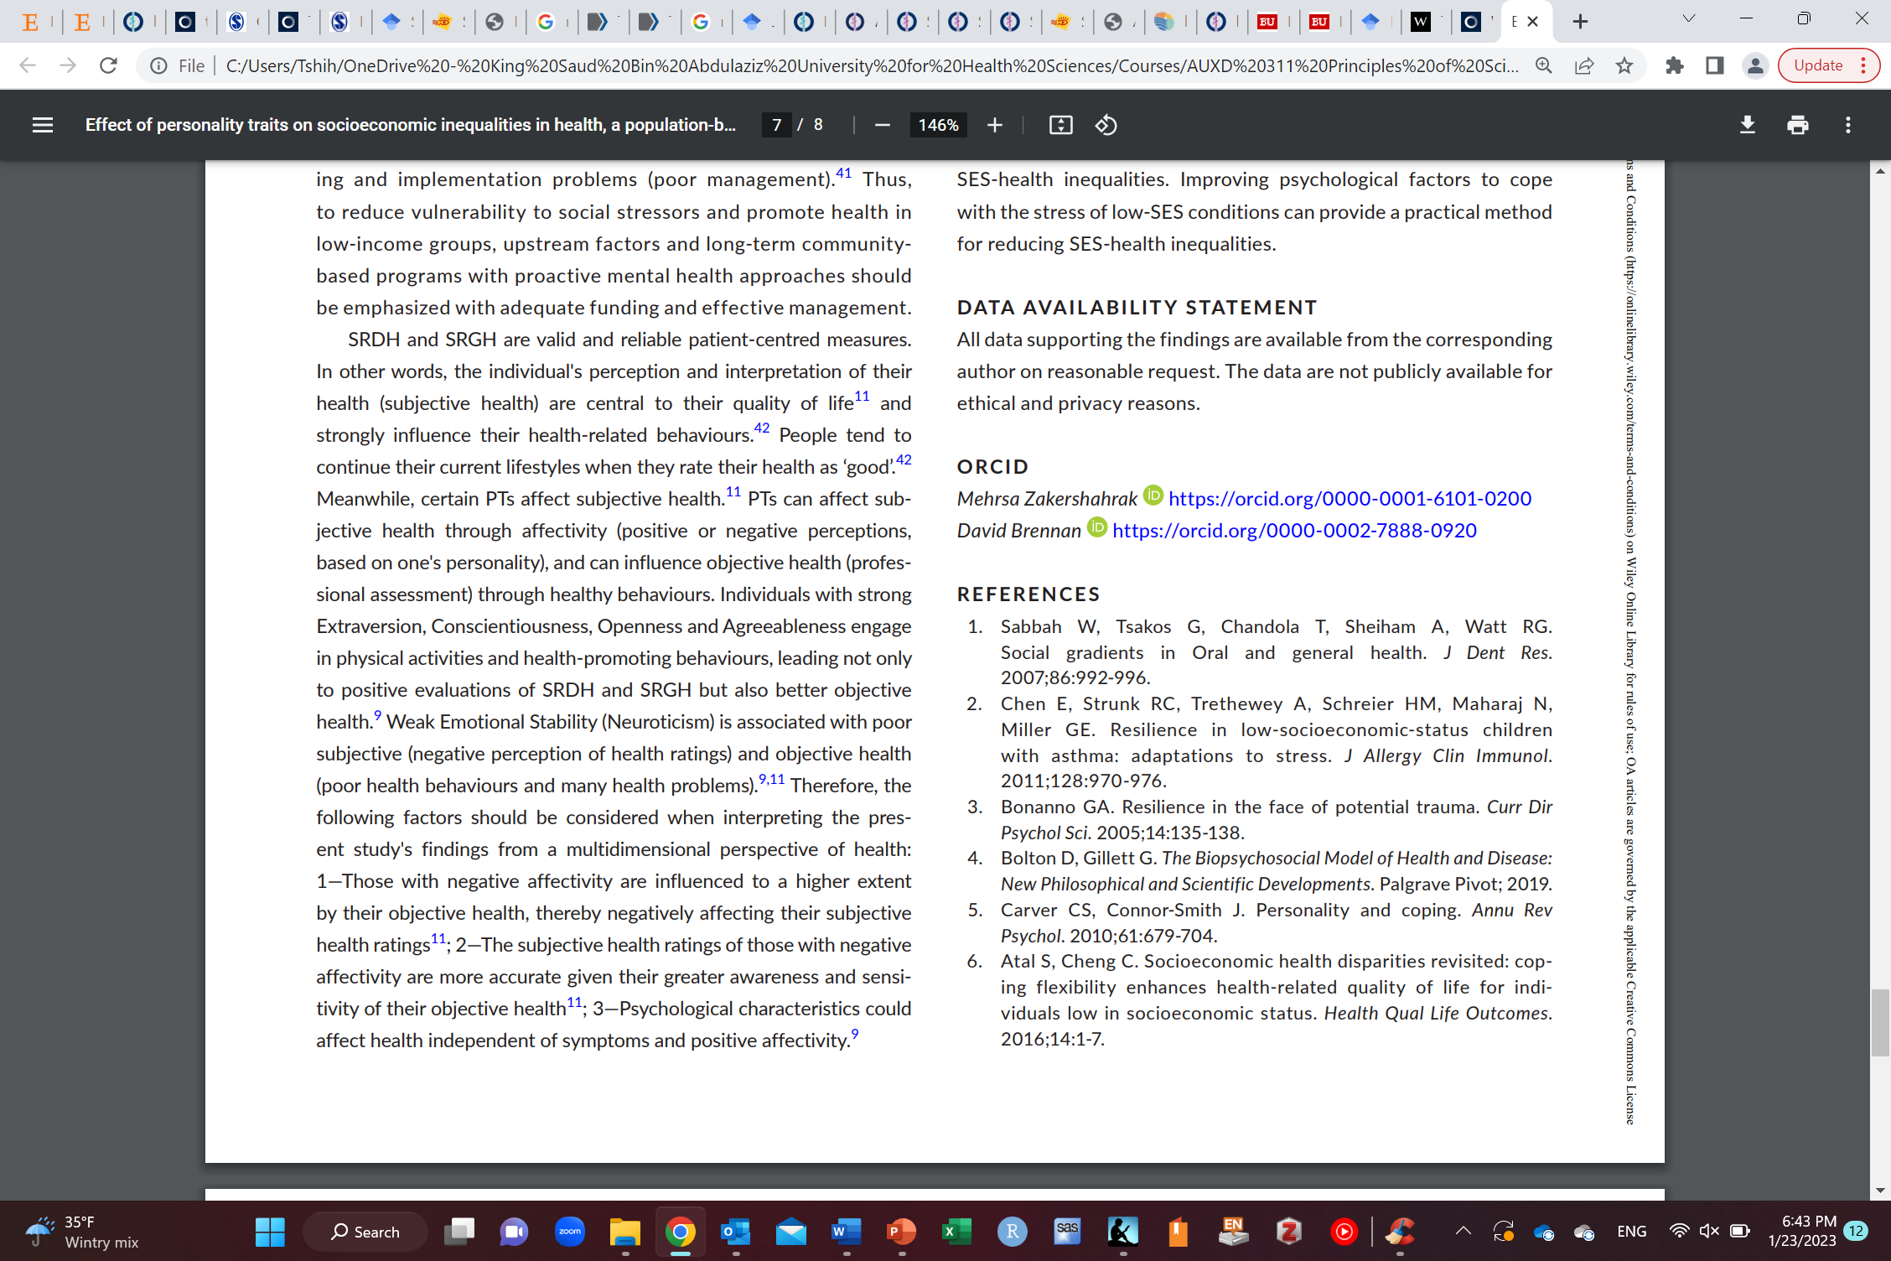

Slide 4
Why use references?

Slide 5
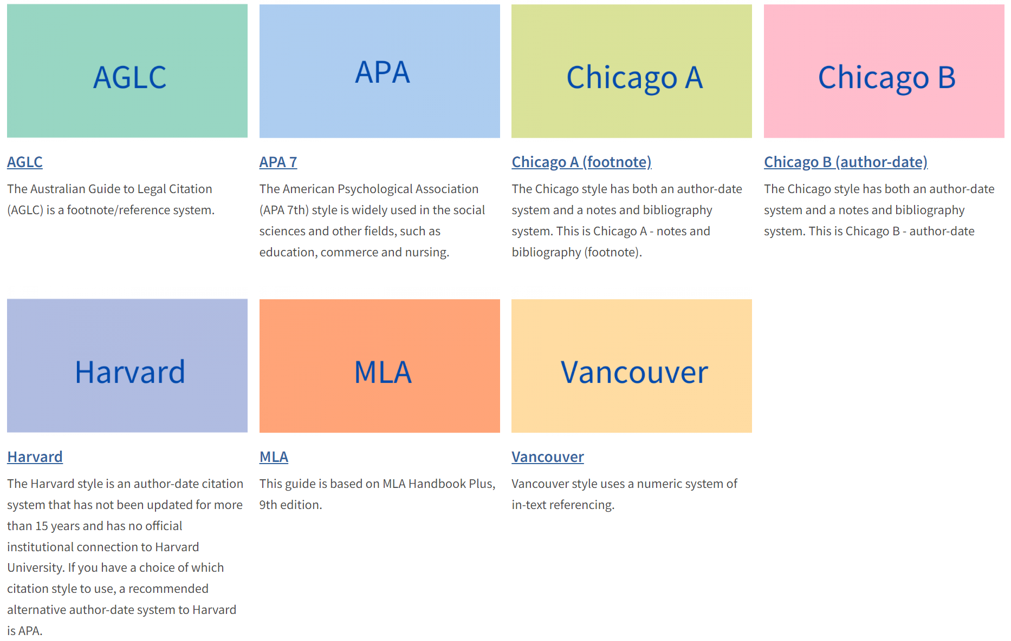
Citations styles
https://library.unimelb.edu.au/recite/referencing-styles

Slide 6
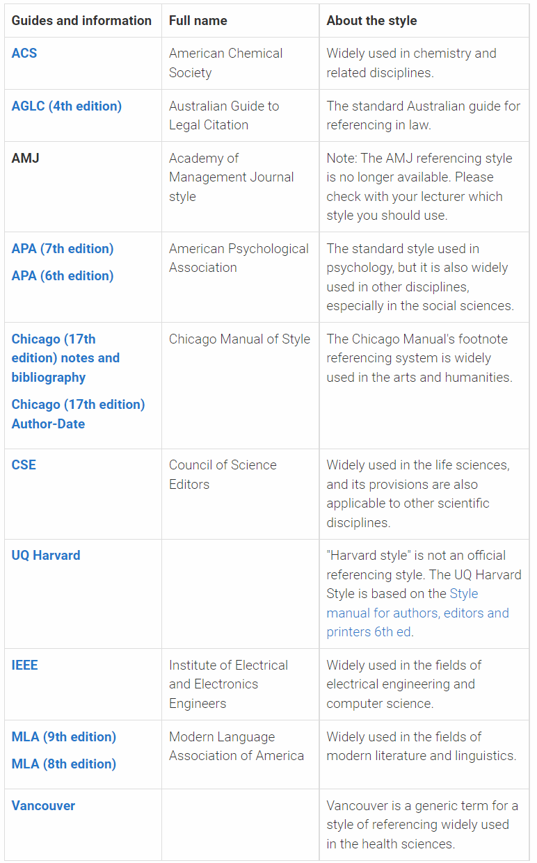
https://guides.library.uq.edu.au/referencing

Slide 7
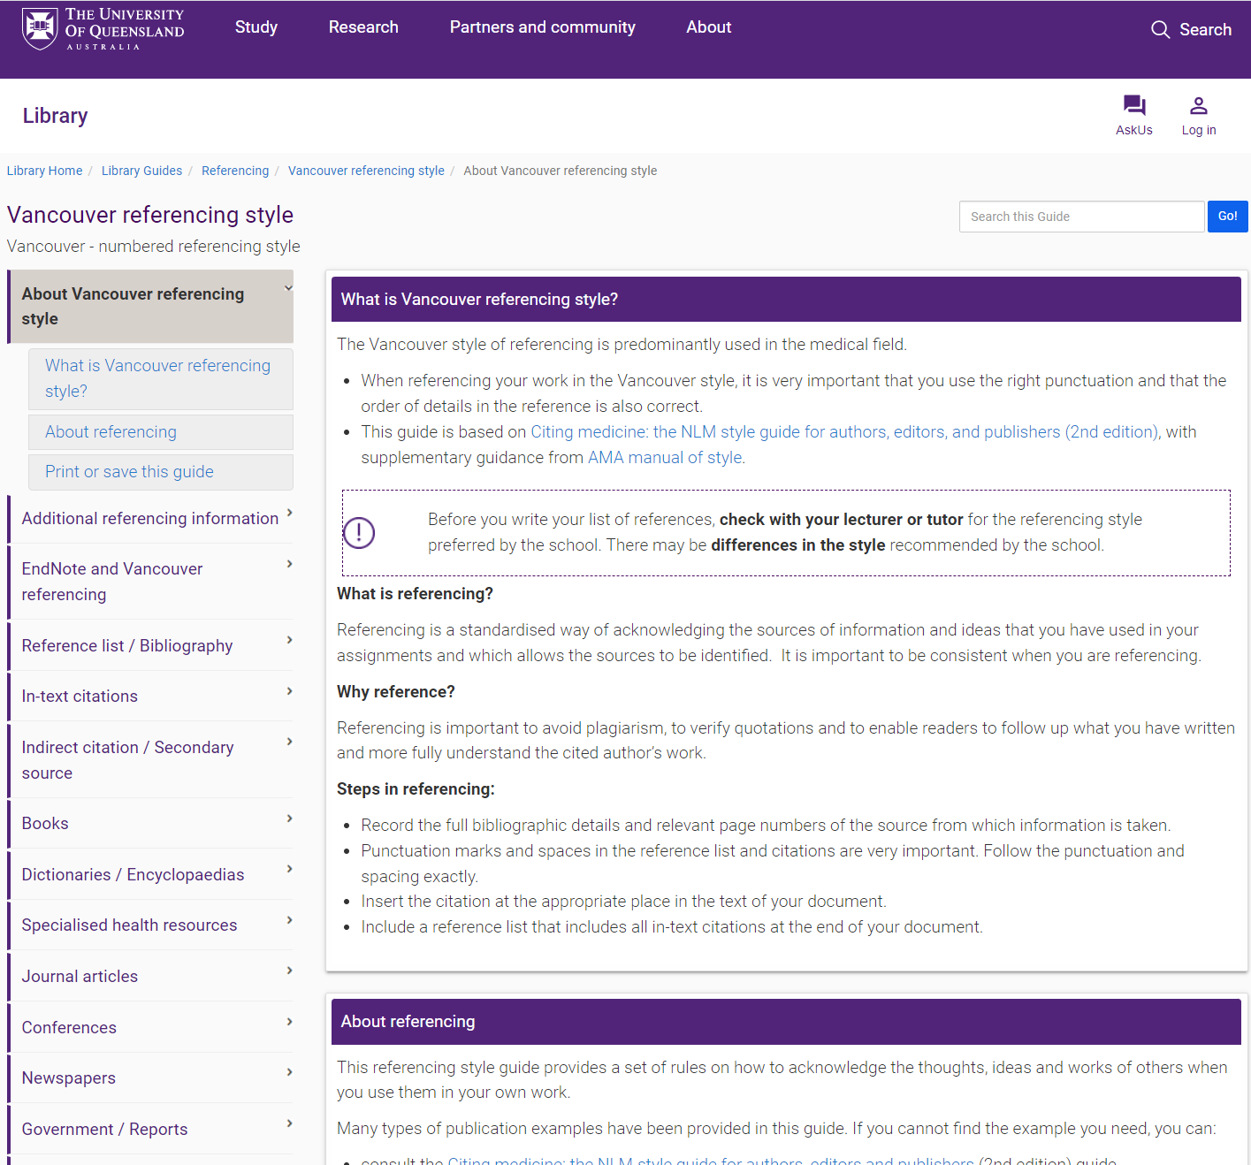
Vancouver
https://guides.library.uq.edu.au/referencing/vancouver

Slide 8
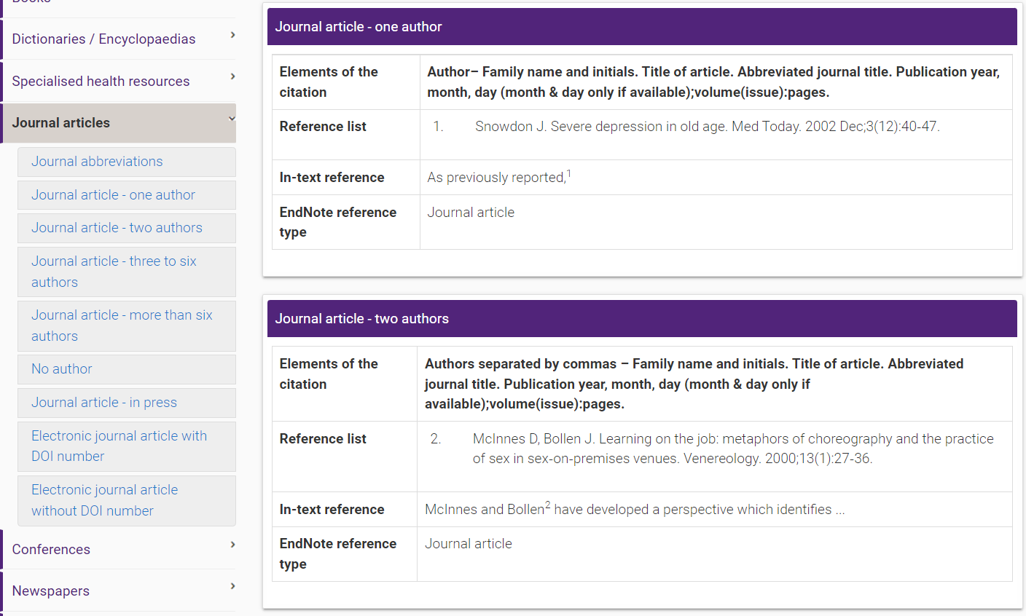
https://guides.library.uq.edu.au/referencing/vancouver/journals

Slide 9
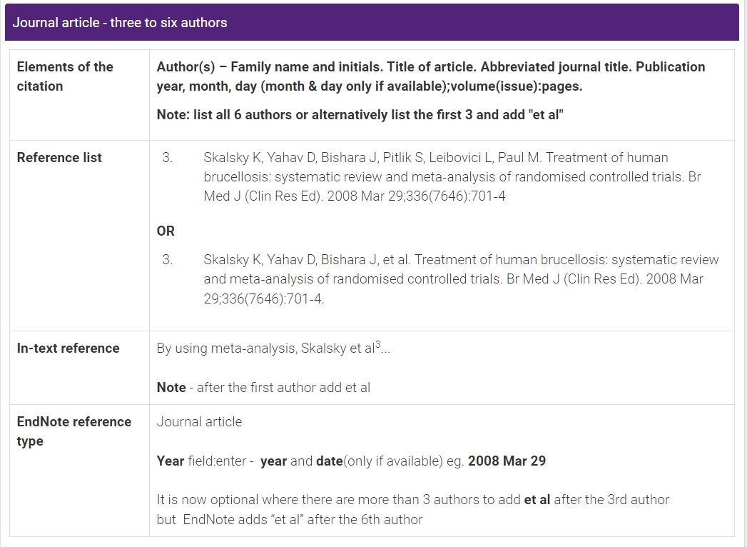
https://guides.library.uq.edu.au/referencing/vancouver/journals

Slide 10
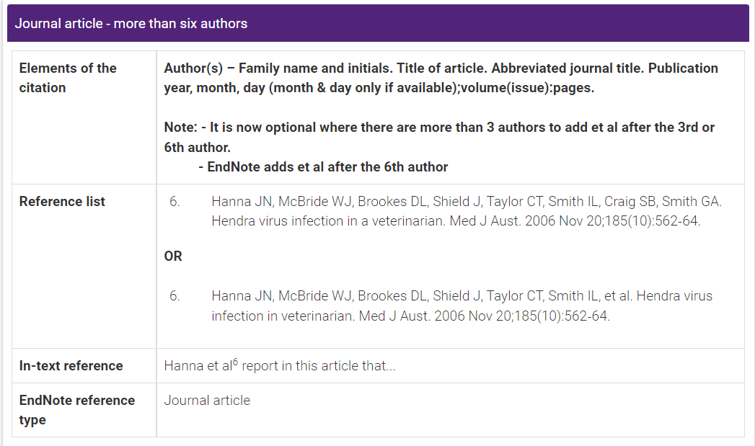
https://guides.library.uq.edu.au/referencing/vancouver/journals

Slide 11
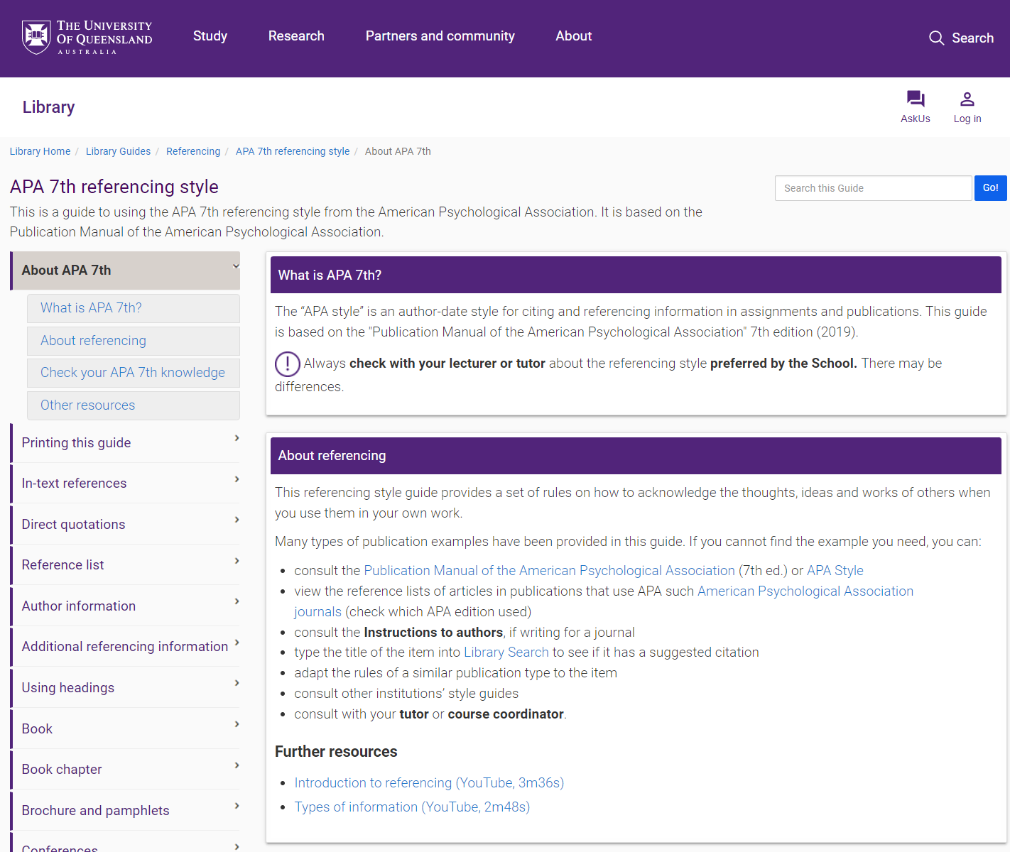
APA 7th
https://guides.library.uq.edu.au/referencing/apa7

Slide 12
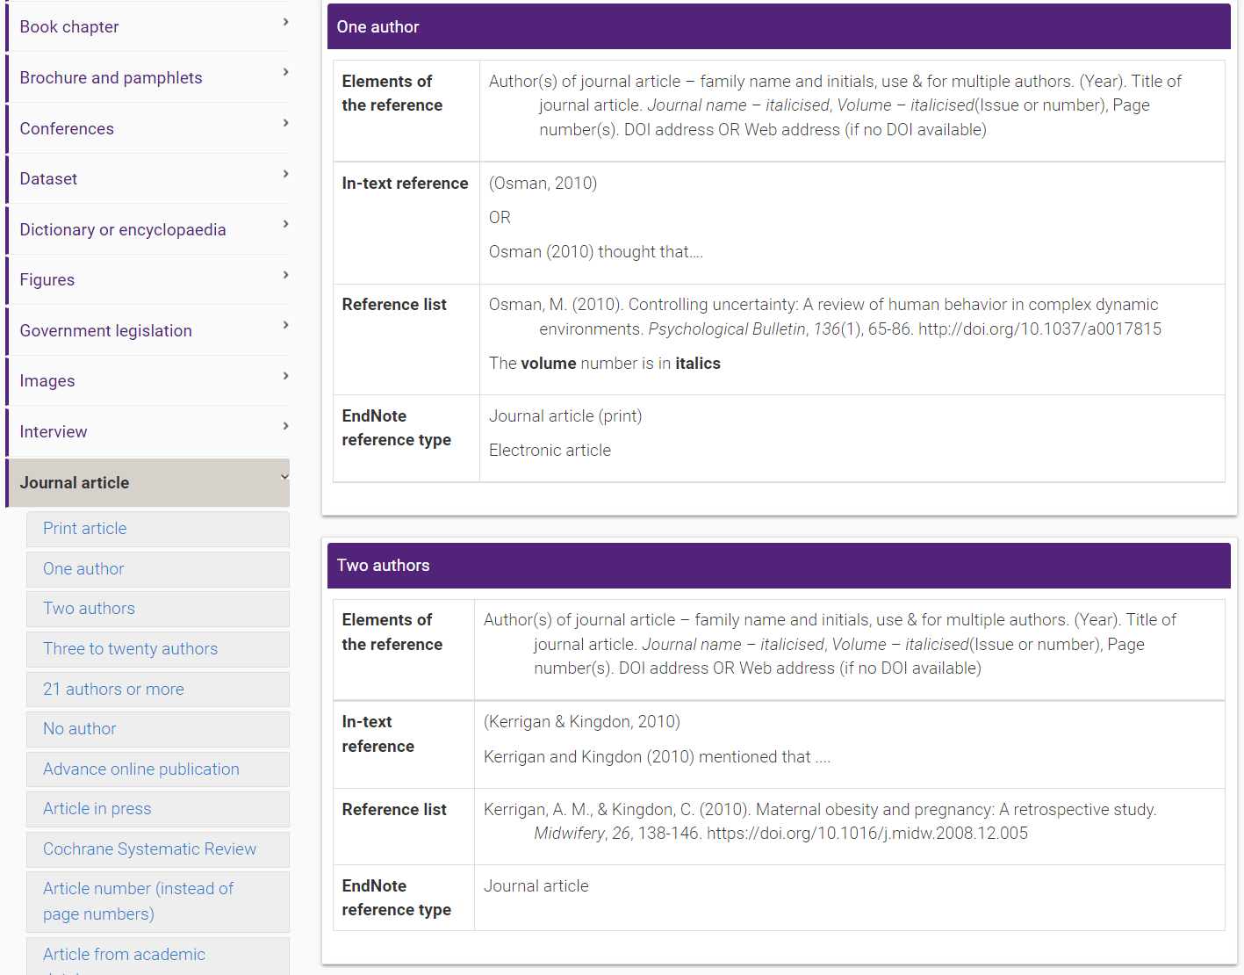
https://guides.library.uq.edu.au/referencing/apa7/journal-articles

Slide 13
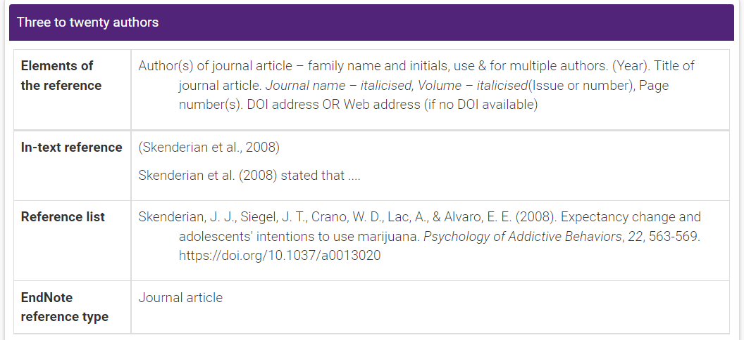
https://guides.library.uq.edu.au/referencing/apa7/journal-articles

Slide 14
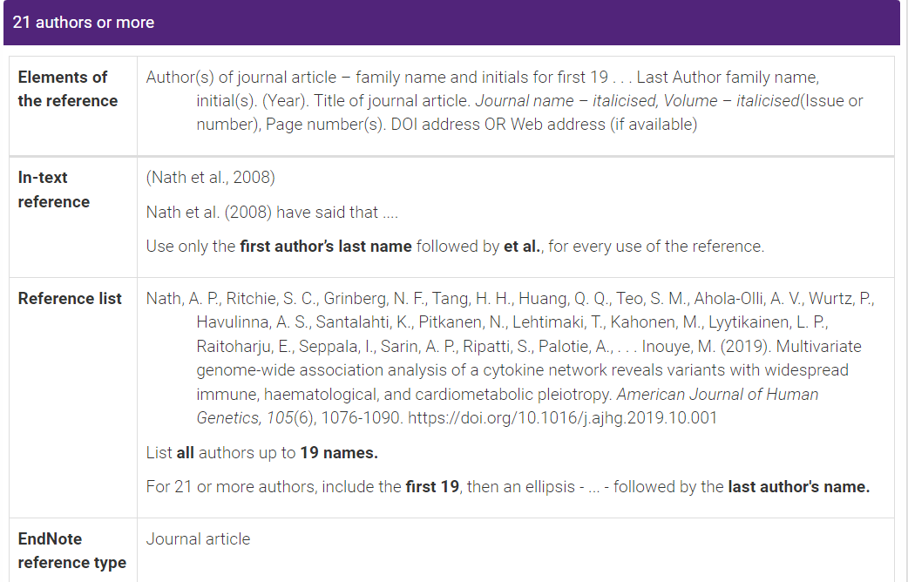
https://guides.library.uq.edu.au/referencing/apa7/journal-articles

Slide 15
Which citation style should I use?
It depends on:
The journal you want to submit your papers to
Your school/mentor/supervisor/course coordinator preference

Slide 16
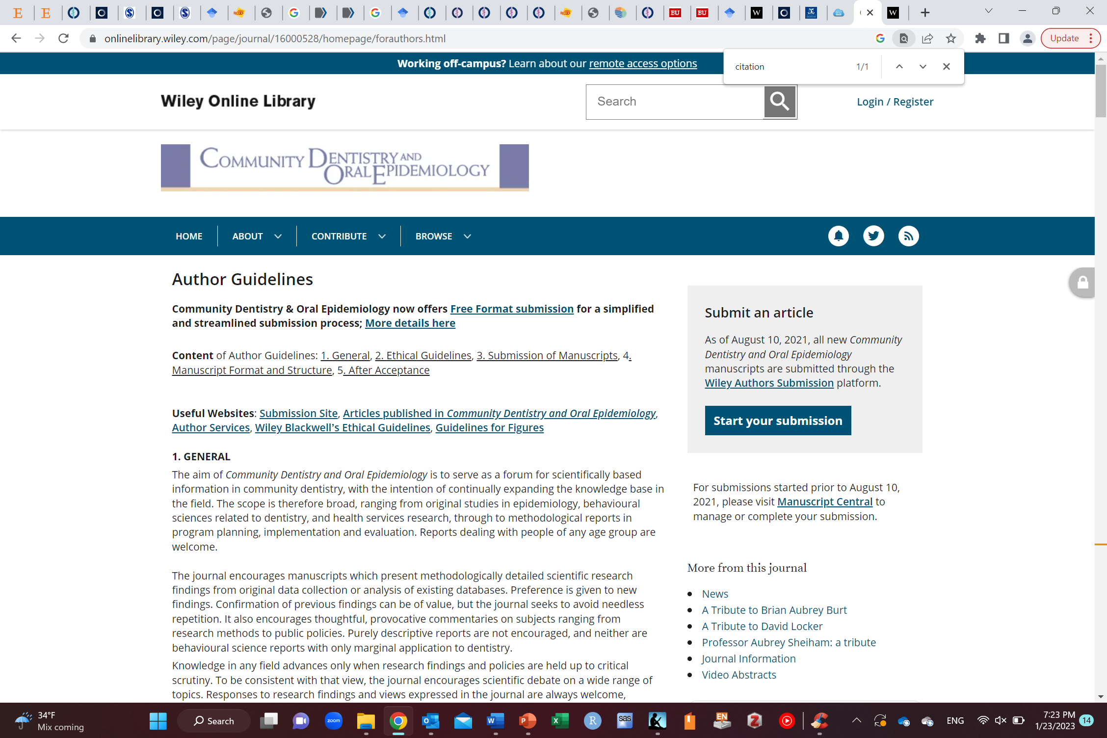
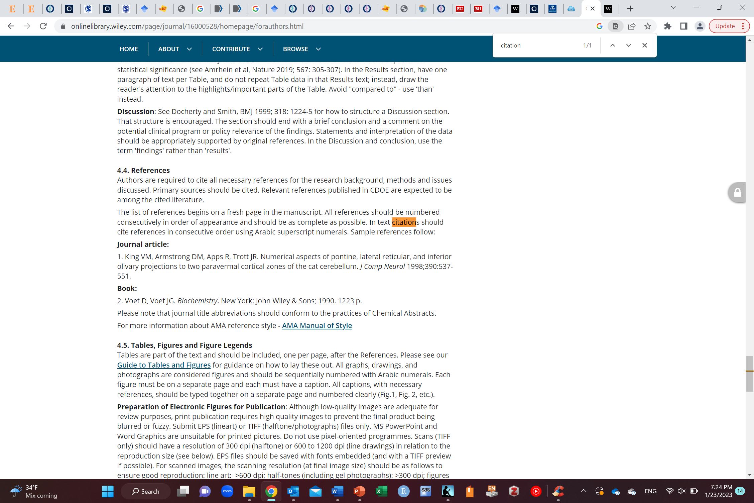

Slide 17
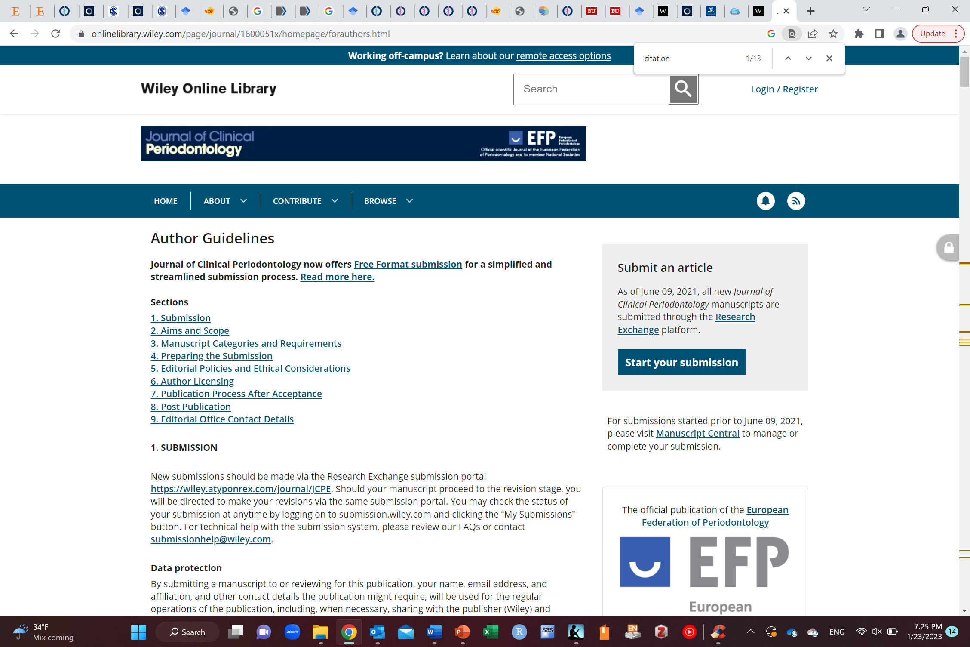
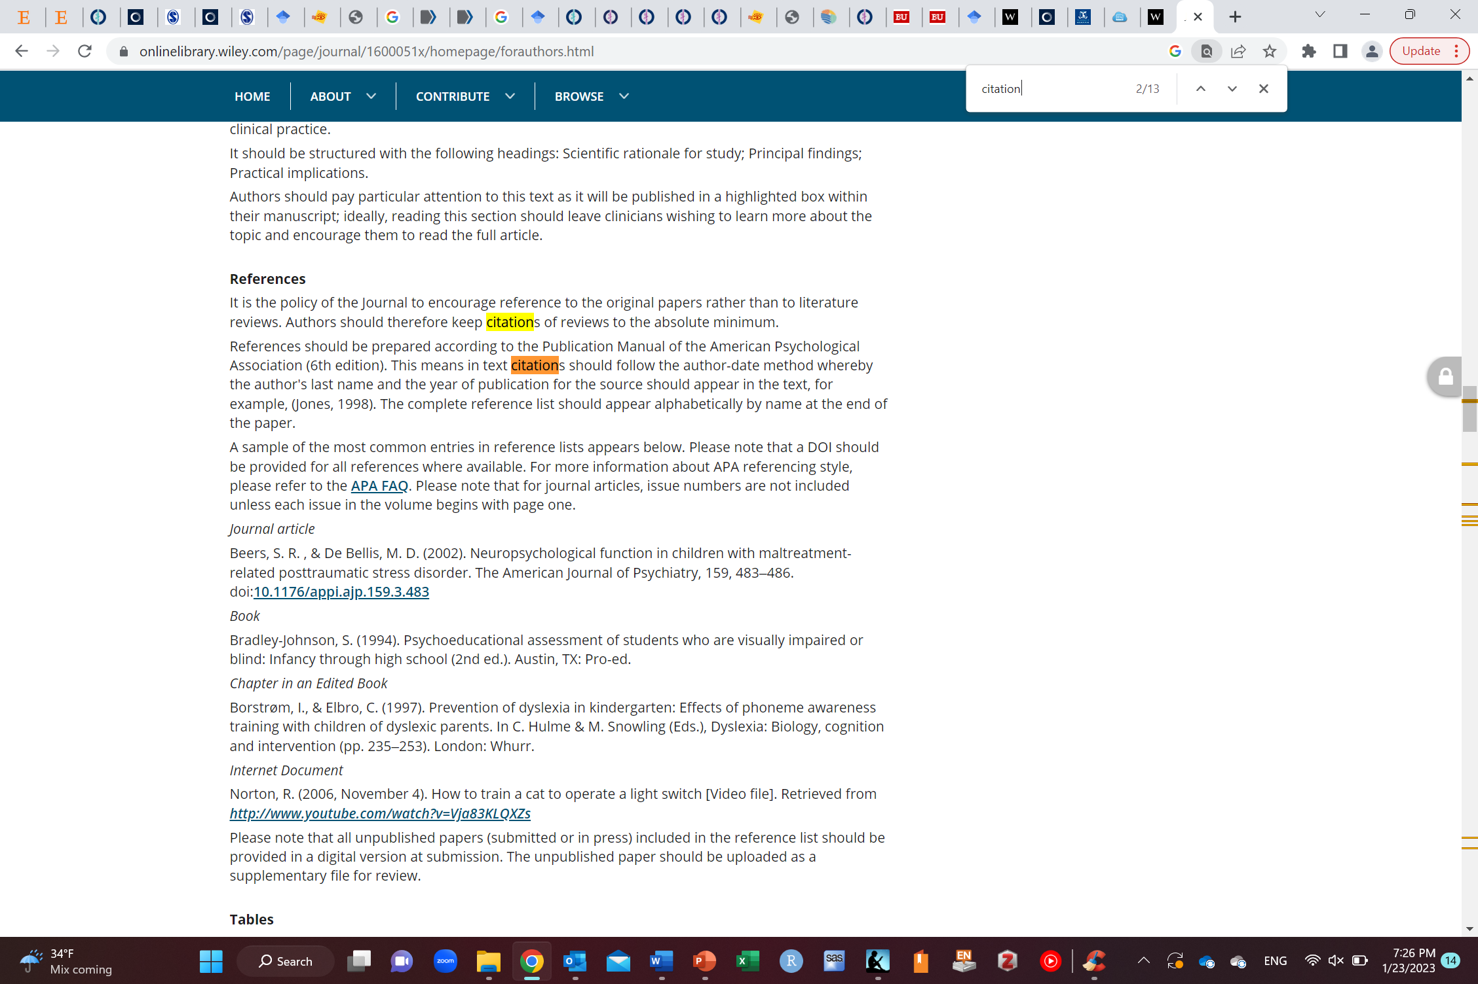

Slide 18
How do you think authors usually work with references?

Slide 19
What is a reference manager?
Software that handles the references in an easier way

Slide 20
Why use a reference manager?
Makes your life much easier!

Slide 21

Reference managers
To manage your reference in a much simpler fashion according to the style of formatting
To cite articles while you write
https://tulib.tudelft.nl/managing-your-information/reference-management/

Slide 22
Tutorials on using reference managers
Endnote: https://www.youtube.com/watch?v=7e6-6QkcYm0
Zotero (free):
https://www.youtube.com/watch?v=OFdhh1fz05A
https://www.youtube.com/watch?v=QJ6Vgy0VCOg
https://www.youtube.com/watch?v=WcIa7iFXnLs
https://www.youtube.com/watch?v=JCqNSlnte_8
Mendeley (free):
https://www.youtube.com/watch?v=XTfVCiksapk
https://www.youtube.com/watch?v=xLtk6n8cFdk
https://www.youtube.com/watch?v=GRqjB7FE-M8

Slide 23
RefWorks (can get it through Saudi digital library)
How to get: https://sdl.edu.sa/SDLPortal/ar/post.aspx?p=9792
Tutorial: https://www.youtube.com/watch?v=J5905oxj02U

Slide 24
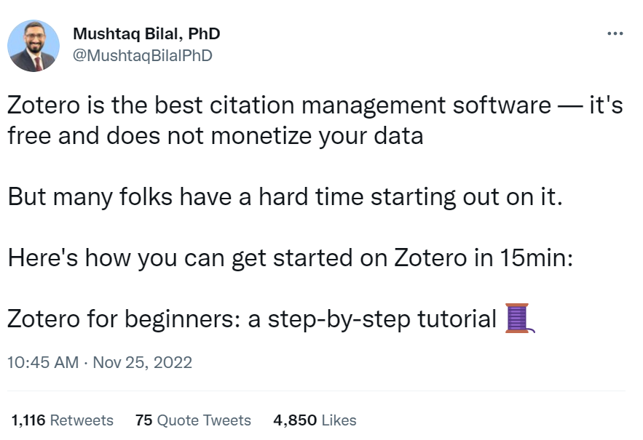
https://twitter.com/MushtaqBilalPhD/status/1596047404255834112

Slide 25
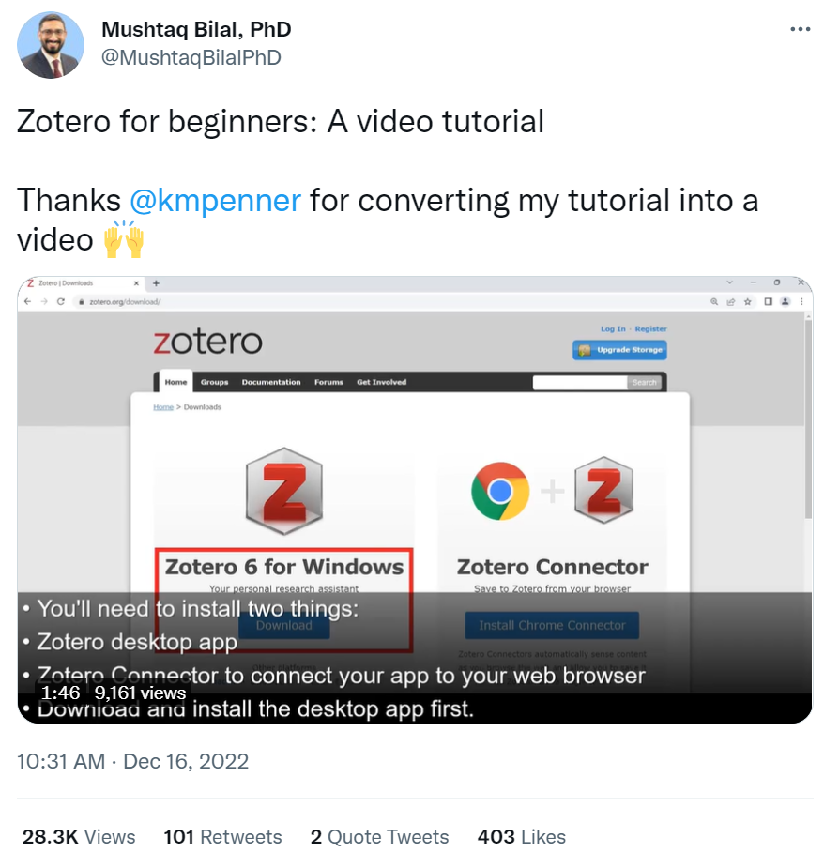
https://twitter.com/MushtaqBilalPhD/status/1603653944466722818

Slide 26
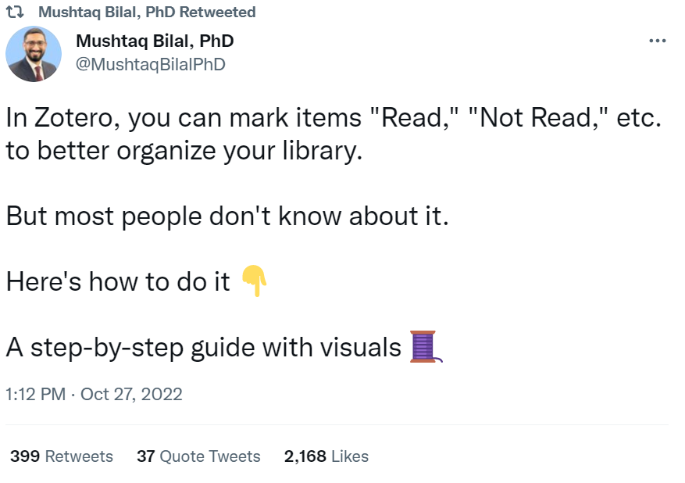
https://twitter.com/MushtaqBilalPhD/status/1585575252872302593

Slide 27
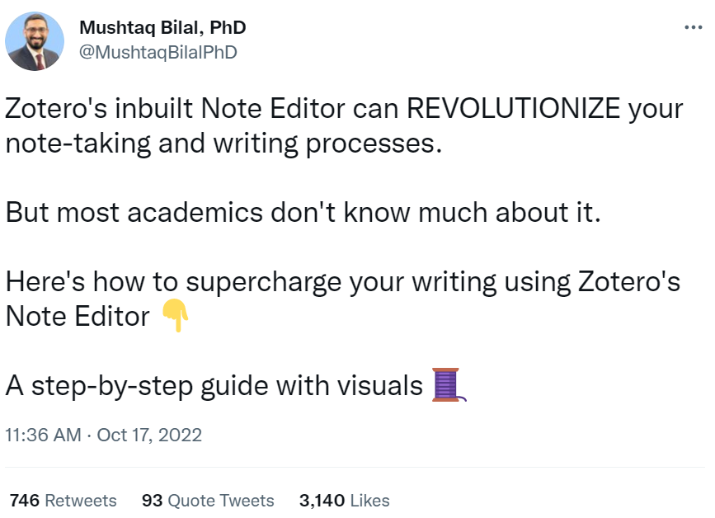
https://twitter.com/MushtaqBilalPhD/status/1581927147685687297

Slide 28
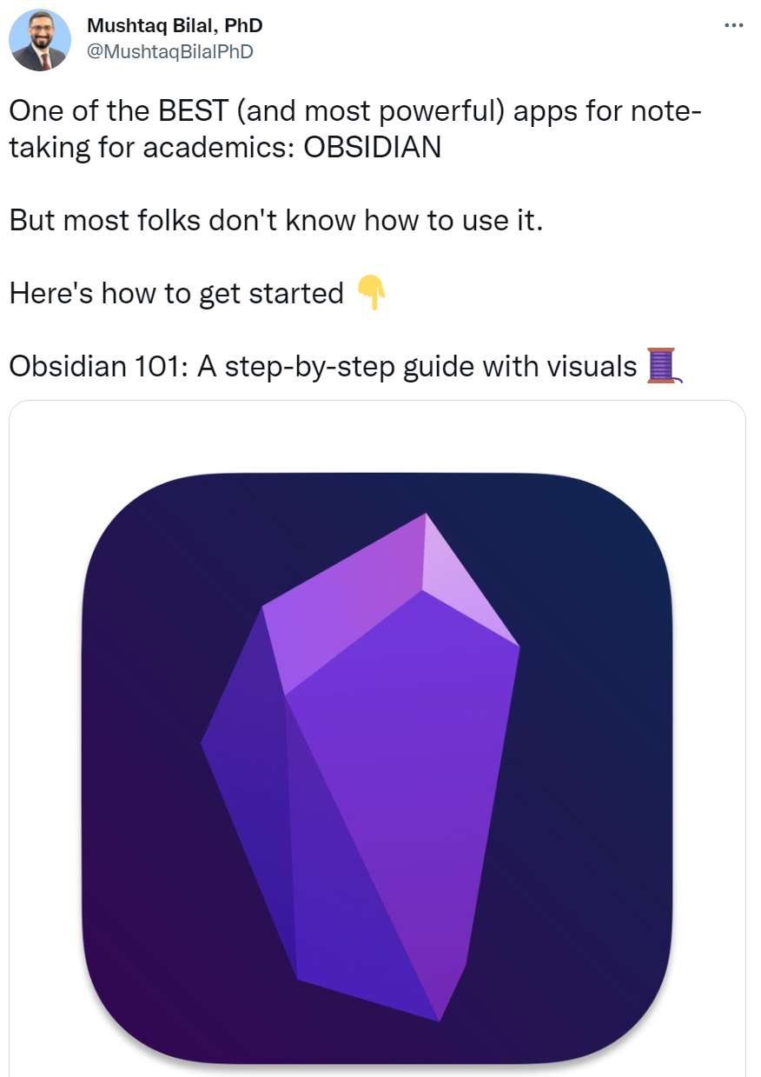
https://twitter.com/MushtaqBilalPhD/status/1602568559284178950

Slide 29
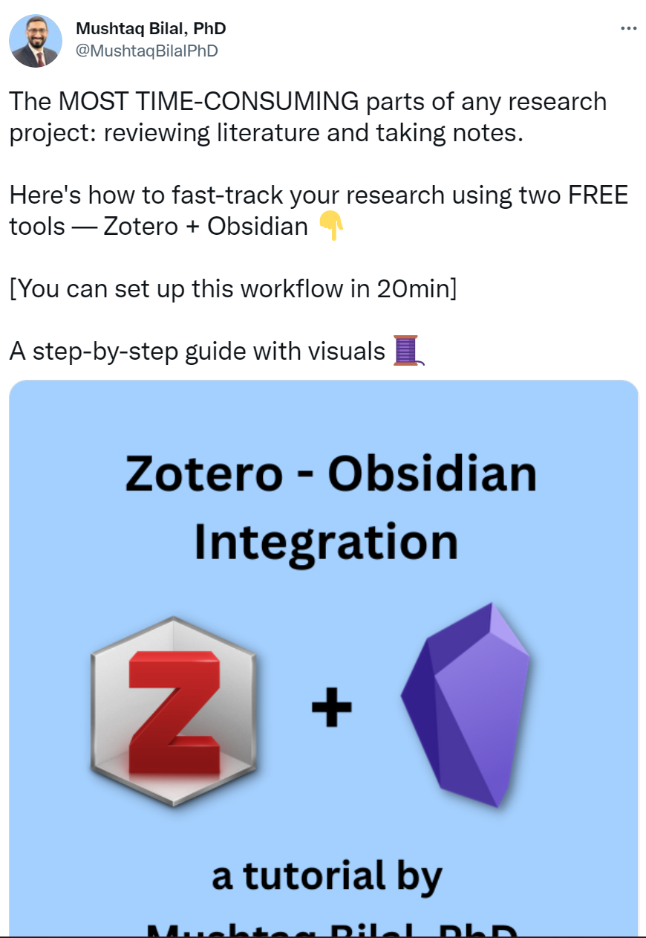
https://twitter.com/MushtaqBilalPhD/status/1603279910537158656

Slide 30
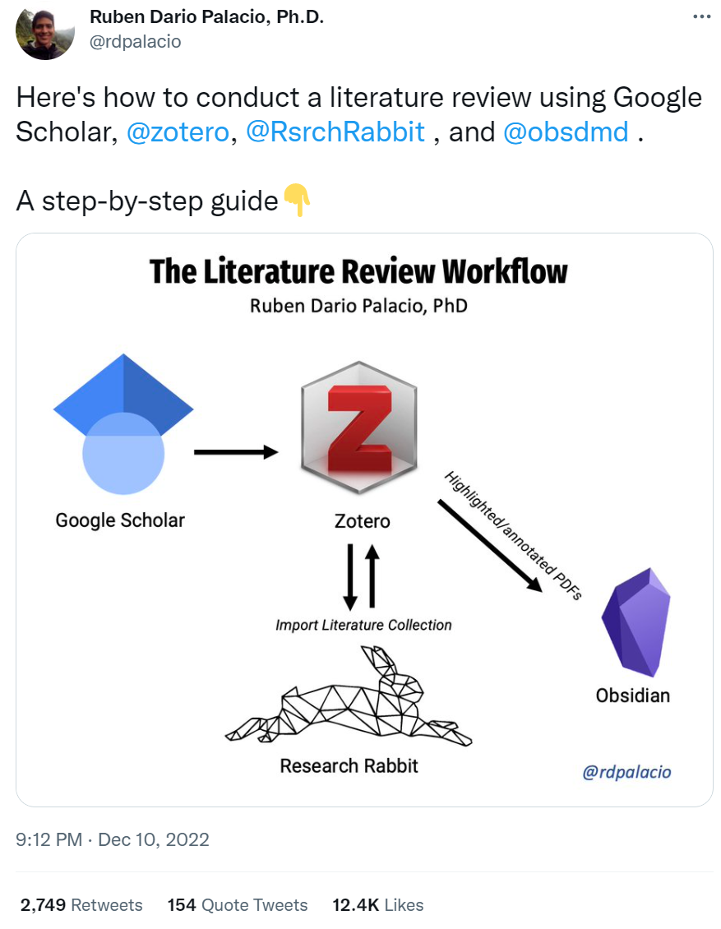
https://twitter.com/rdpalacio/status/1601640985858957312

Slide 31
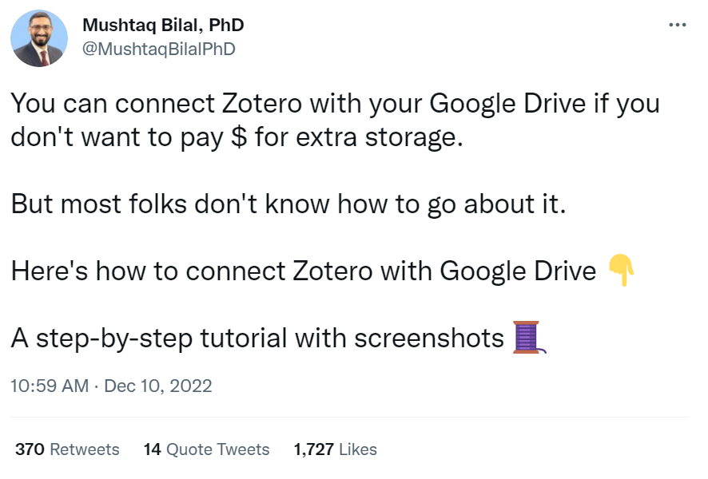
https://twitter.com/MushtaqBilalPhD/status/1601486695618072576

Slide 32
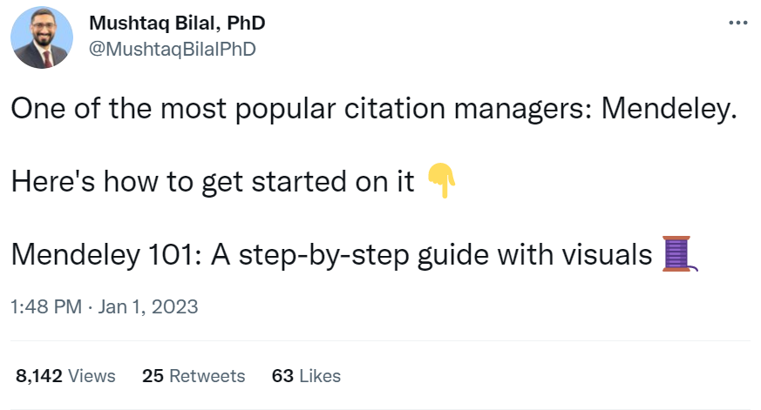
https://twitter.com/MushtaqBilalPhD/status/1609501702935433216

Slide 33
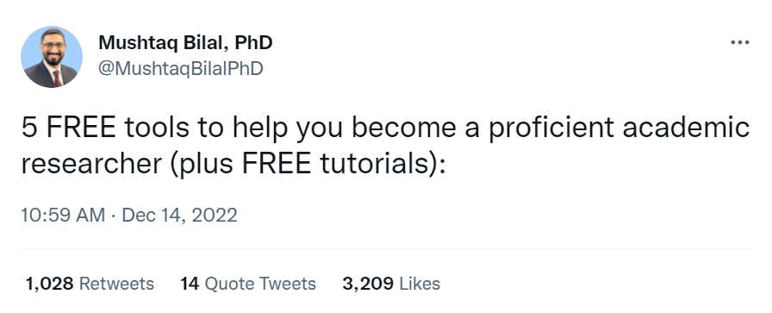
https://twitter.com/MushtaqBilalPhD/status/1602936336222134274

Slide 34
Any Questions?
shihaybt@ksau-hs.edu.sa

